Slide 1
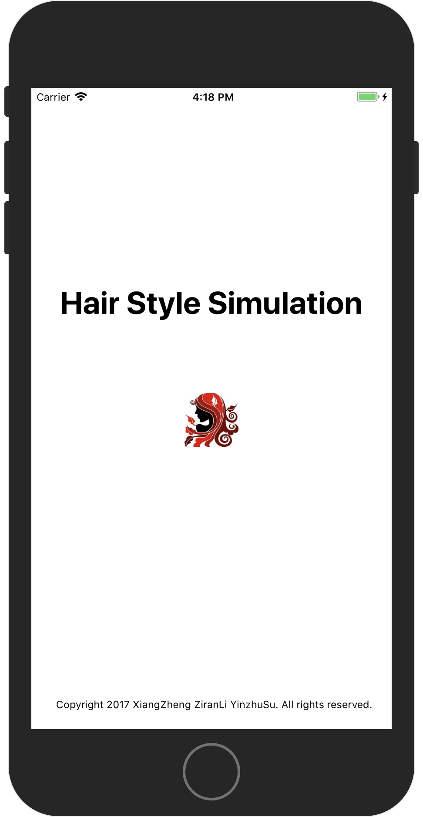
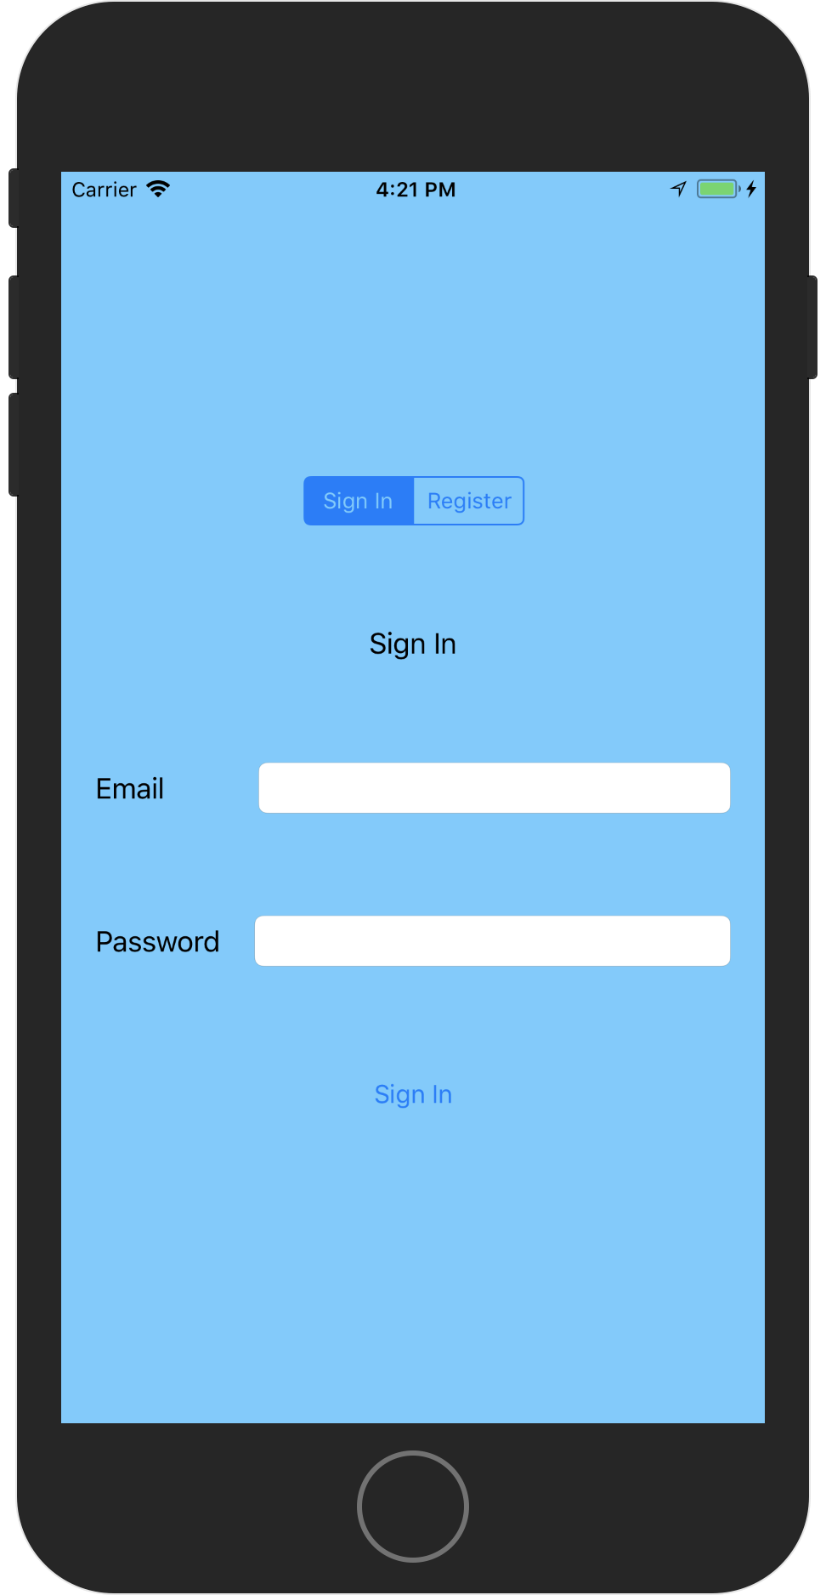

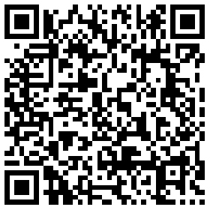
HAIR STYLE SIMULATION
Designed by Xiang Zheng, Ziran Li and Yinzhu Su
Github https://github.com/ZiranLi/HairStyleSimulation Trello https://trello.com/b/KEP6SeFv/hair-style-simulation1
What is HSS?
iOS application
Detects human hair part
User interaction
Recommends of hairstyles
Try new hairstyles on!
Log In System
Sign in if have registered
Register with email
Google Firebase

